Slide 1

React JS
Declarative approach that developers needed
Short overview of the most popular tool for creating user interfaces
by ishandry

Slide 2



Get started
At the end of the presentation, you will:
understand 90% of React code
know how React works
be aware of the tools frequently used with React

Slide 3
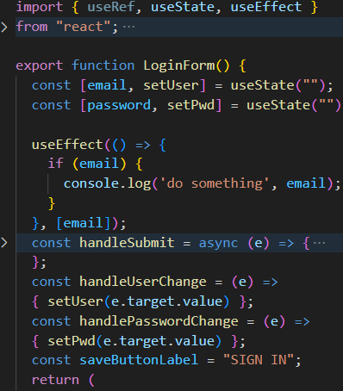
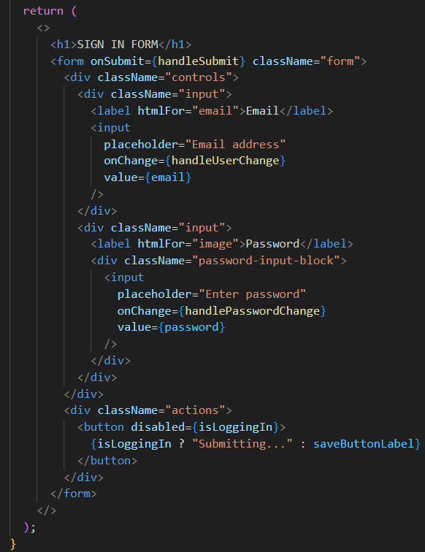
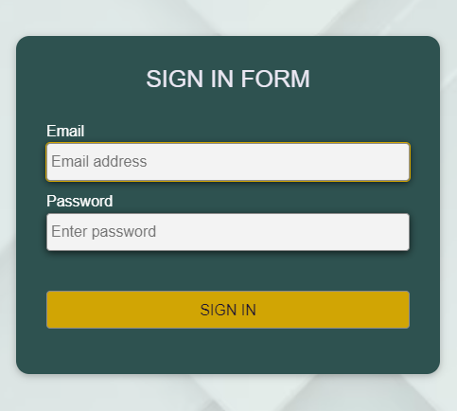
Hands on example: login form

Slide 4
Login form breakdown
Imports
React functional component
JSX

Slide 5
Login form breakdown
One can think of it as:
let loginForm = document.getElementById("loginForm");
loginForm.addEventListener("submit", (e) => { … }
Imports
React functional component
document.getElementById(“email").value = email;
JSX

Slide 6
Login form breakdown
Imports
React functional component
JSX

Slide 7
Login form breakdown
JSX

Slide 8
Component’s state. UseState hook

Slide 9
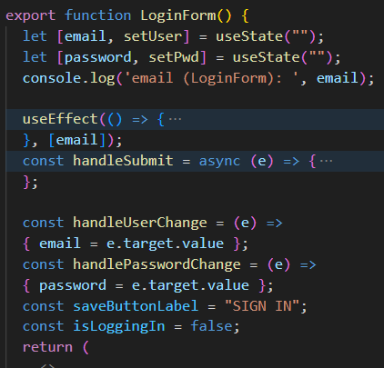

Component’s state. How it works

Slide 10
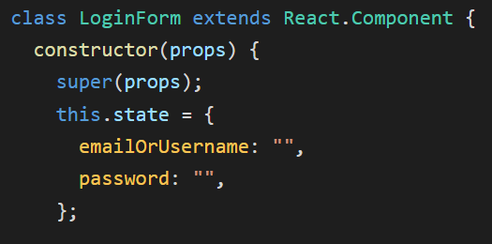
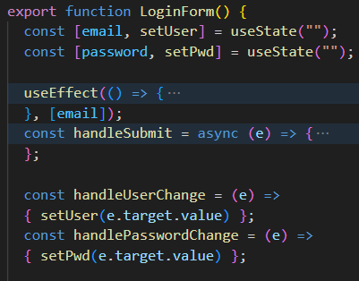
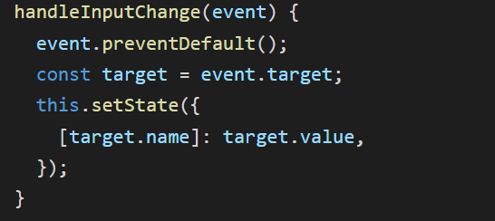
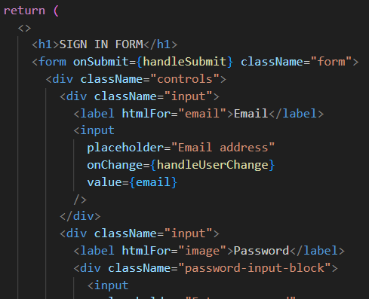
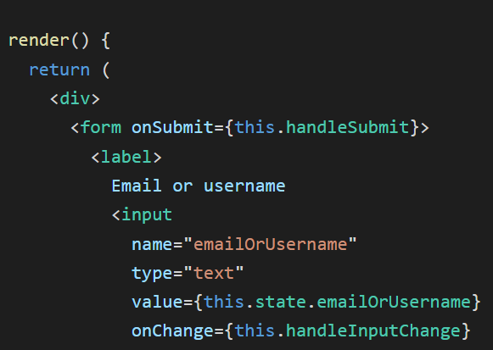
A word about class-based components
Current standard. Introduced in React v16.8
VS

Slide 11
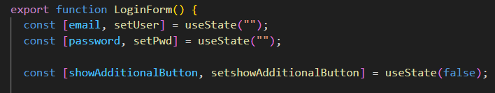
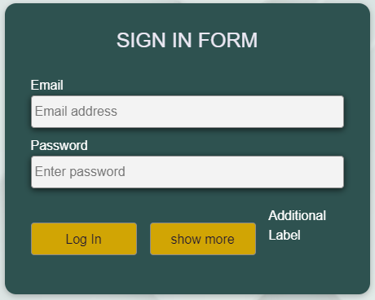
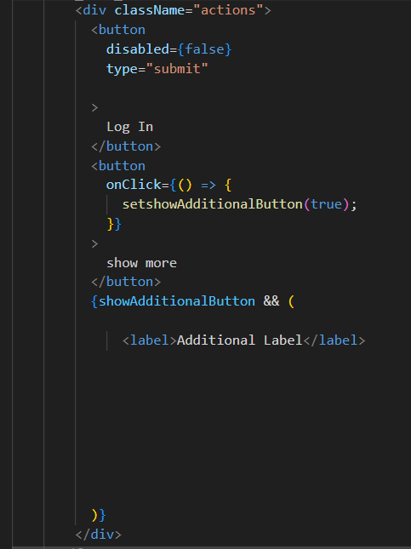
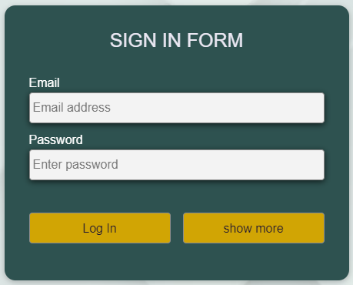
Add more state

Slide 12

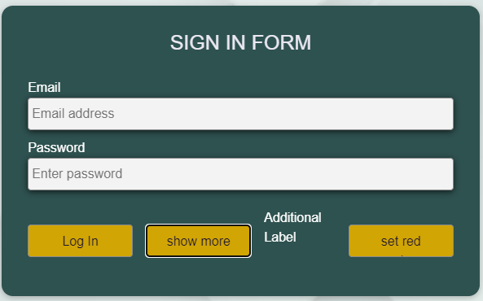
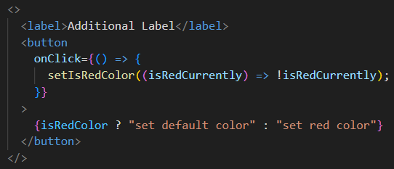
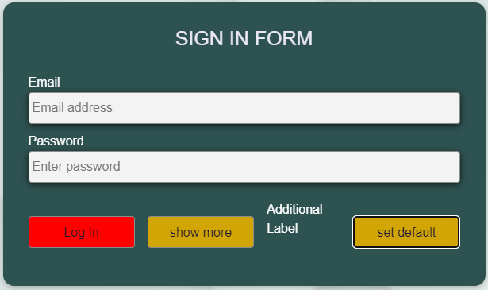
Add more state

Slide 13
Add more state

Slide 14
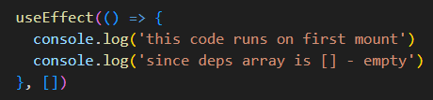
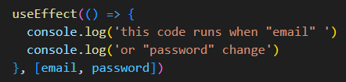
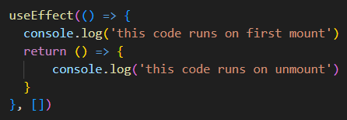
Component’s life cycle. UseEffect()
Mounting Phase
Updating Phase
Unmounting Phase
React hooks:
React class-based components:
Constructor()
getDerivedStateFromProps()
componentDidMount()
shouldComponentUpdate()
componentWillUpdate()
componentDidUpdate()
componentWillUnmount()

Slide 15
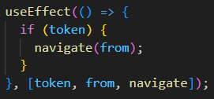
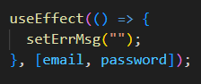
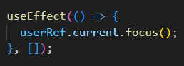
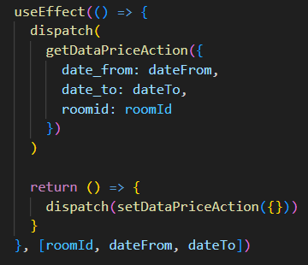
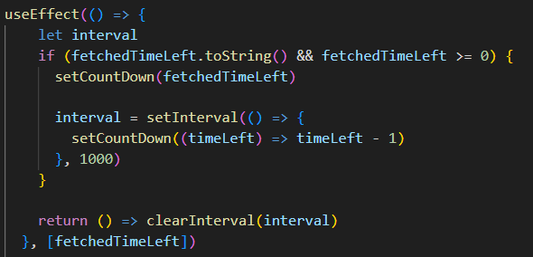
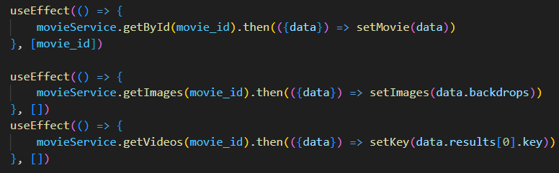
UseEffect() Usage examples

Slide 16
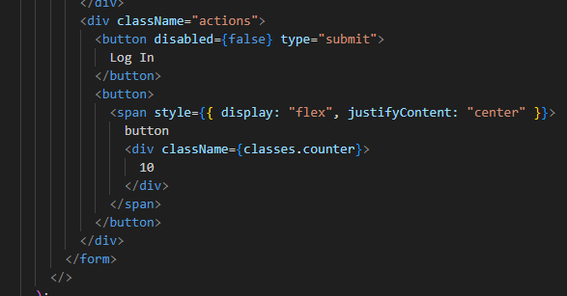
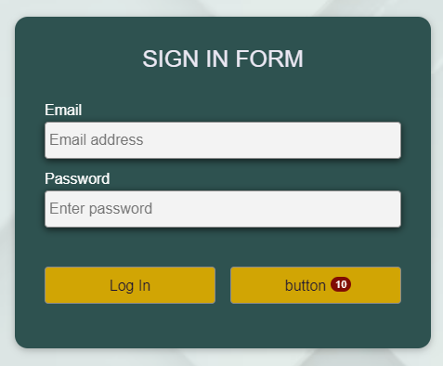
Props. Custom JSX elements

Slide 17
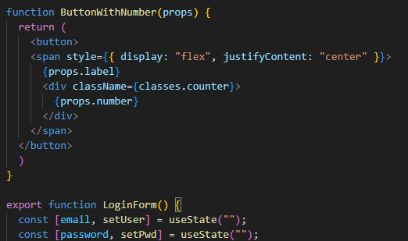
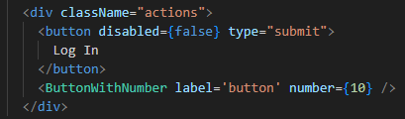
Props. Custom JSX elements

Slide 18
Props. Custom JSX elements

Slide 19
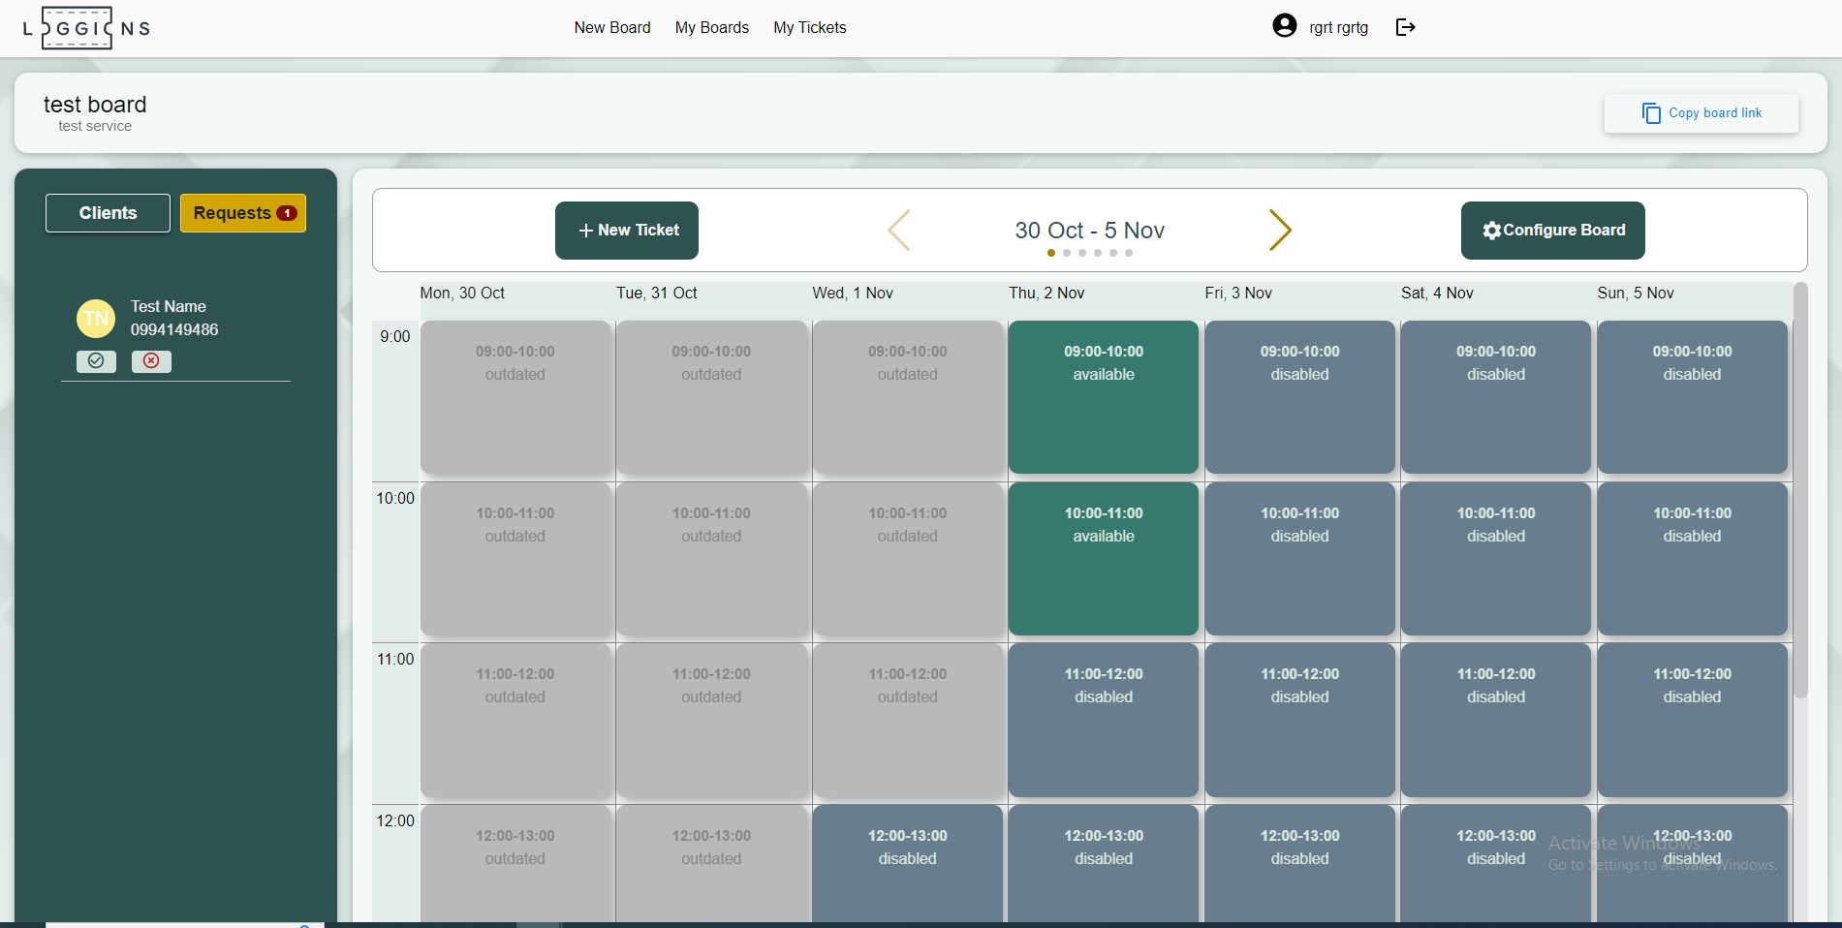
Custom JSX elements

Slide 20
Custom JSX elements

Slide 21
Custom JSX elements

Slide 22
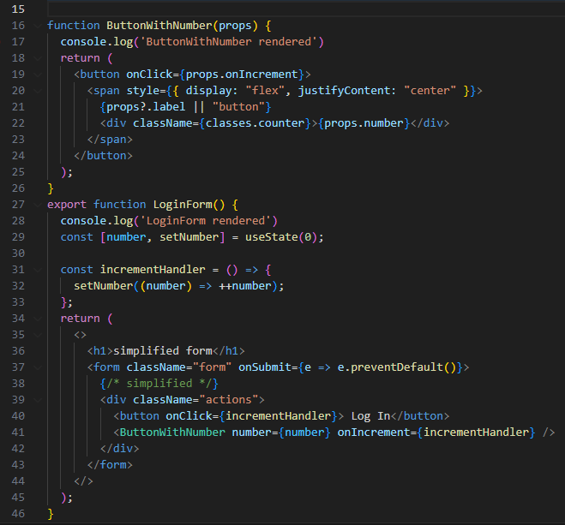
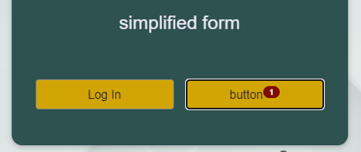
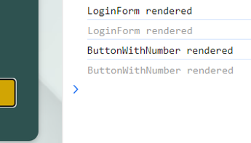
Props. Passing data up and down the tree
data down
data up

Slide 23
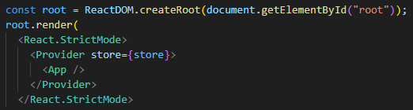
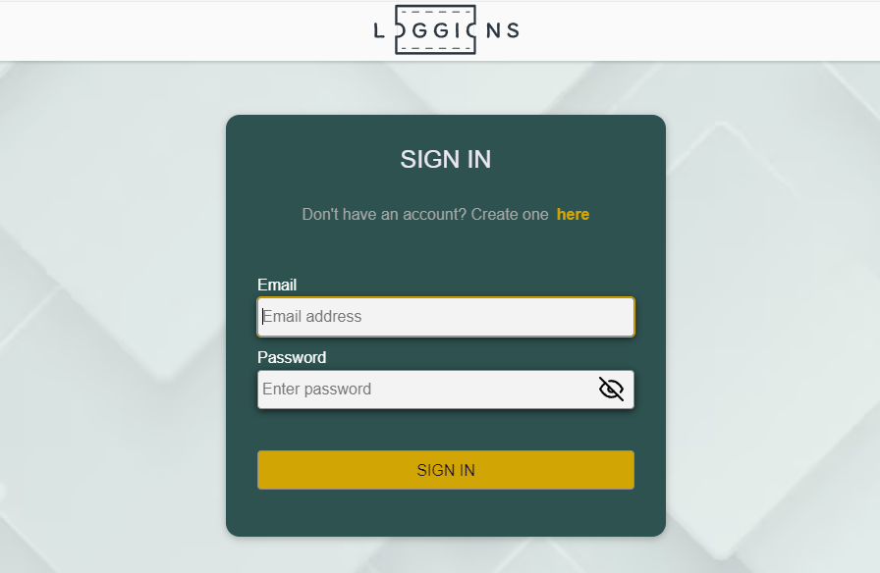
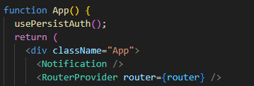
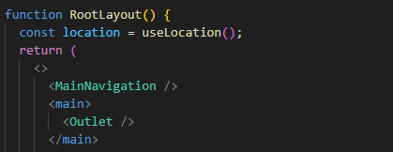
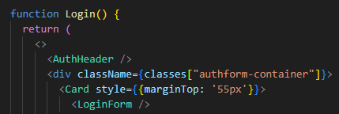
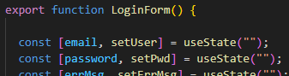

The tree. SPA

Slide 24
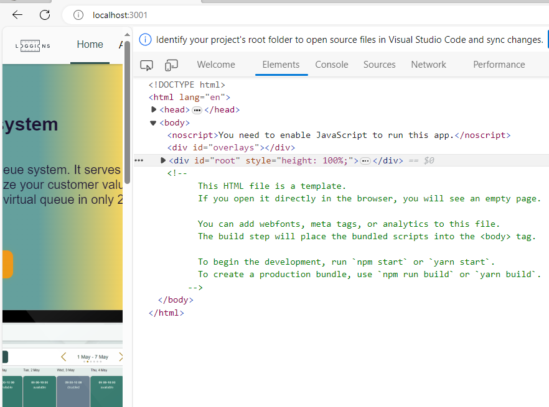
The tree. SPA

Slide 25
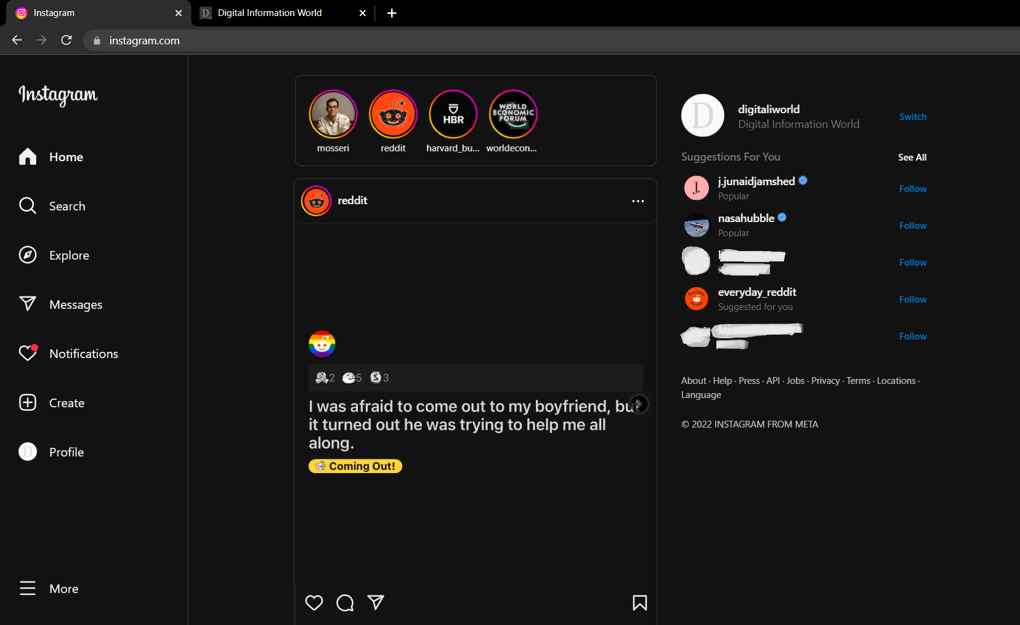
Uses ReactJS: Instagram

Slide 26
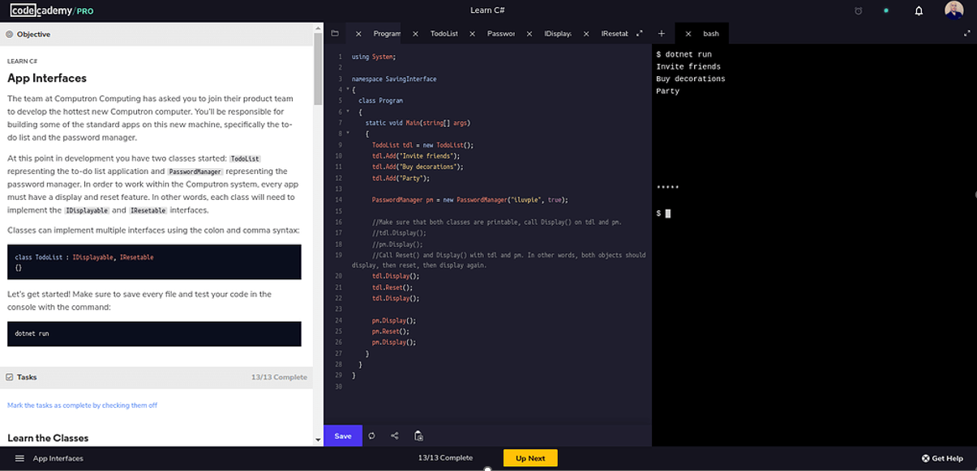
Uses ReactJS: Codecademy

Slide 27
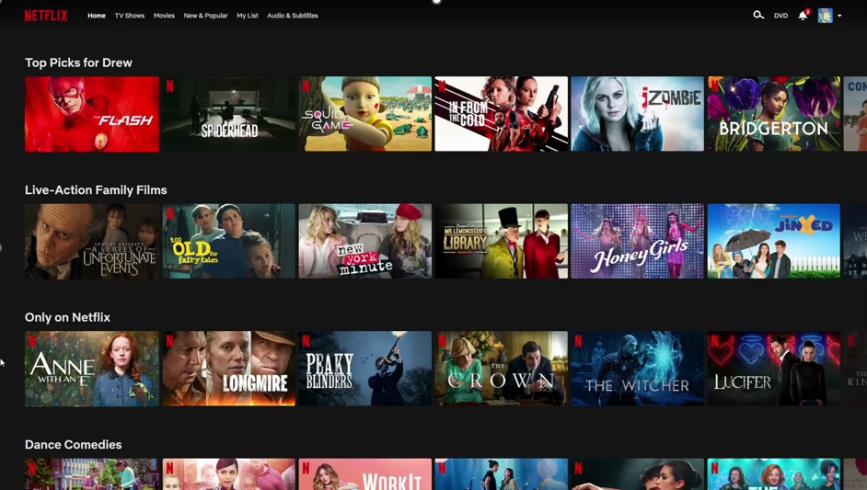

Uses ReactJS: Netflix

Slide 28
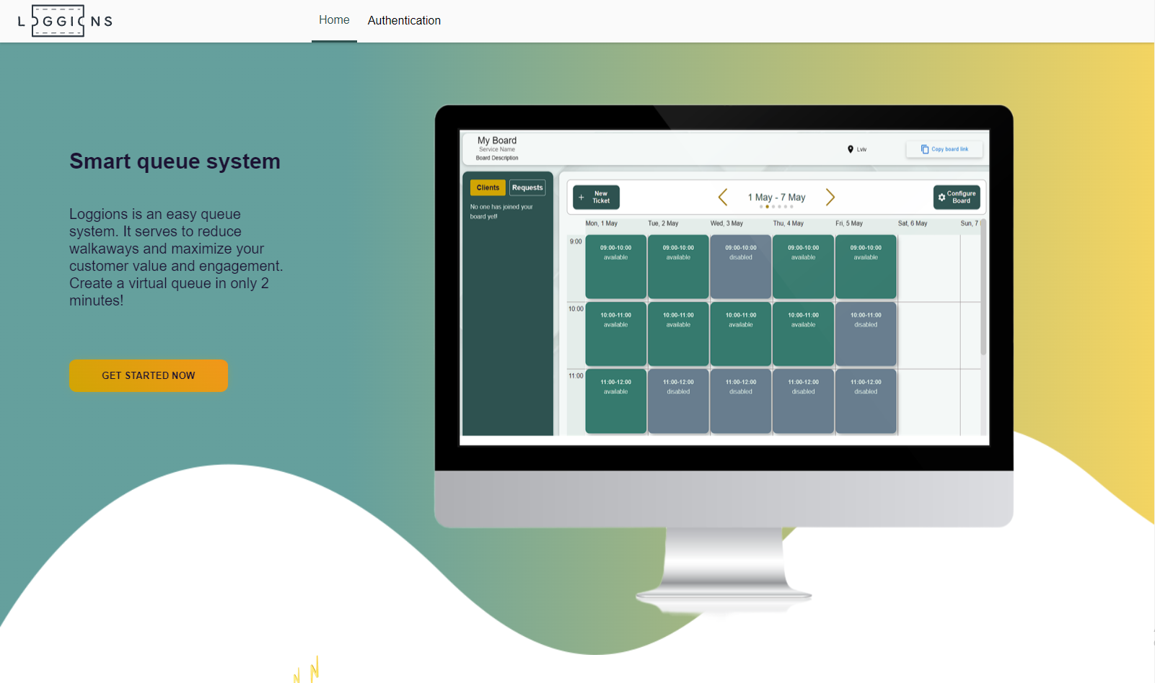
Uses ReactJS: Loggions

Slide 29
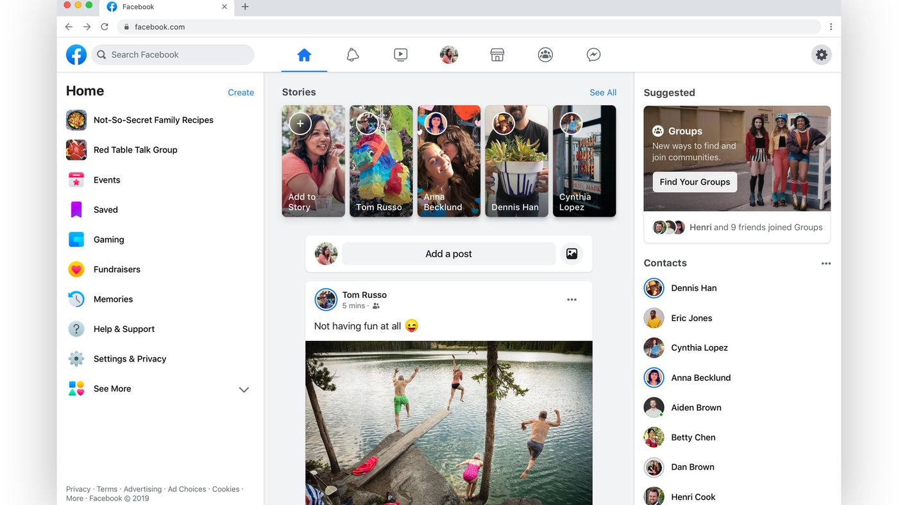
Uses ReactJS: Facebook

Slide 30
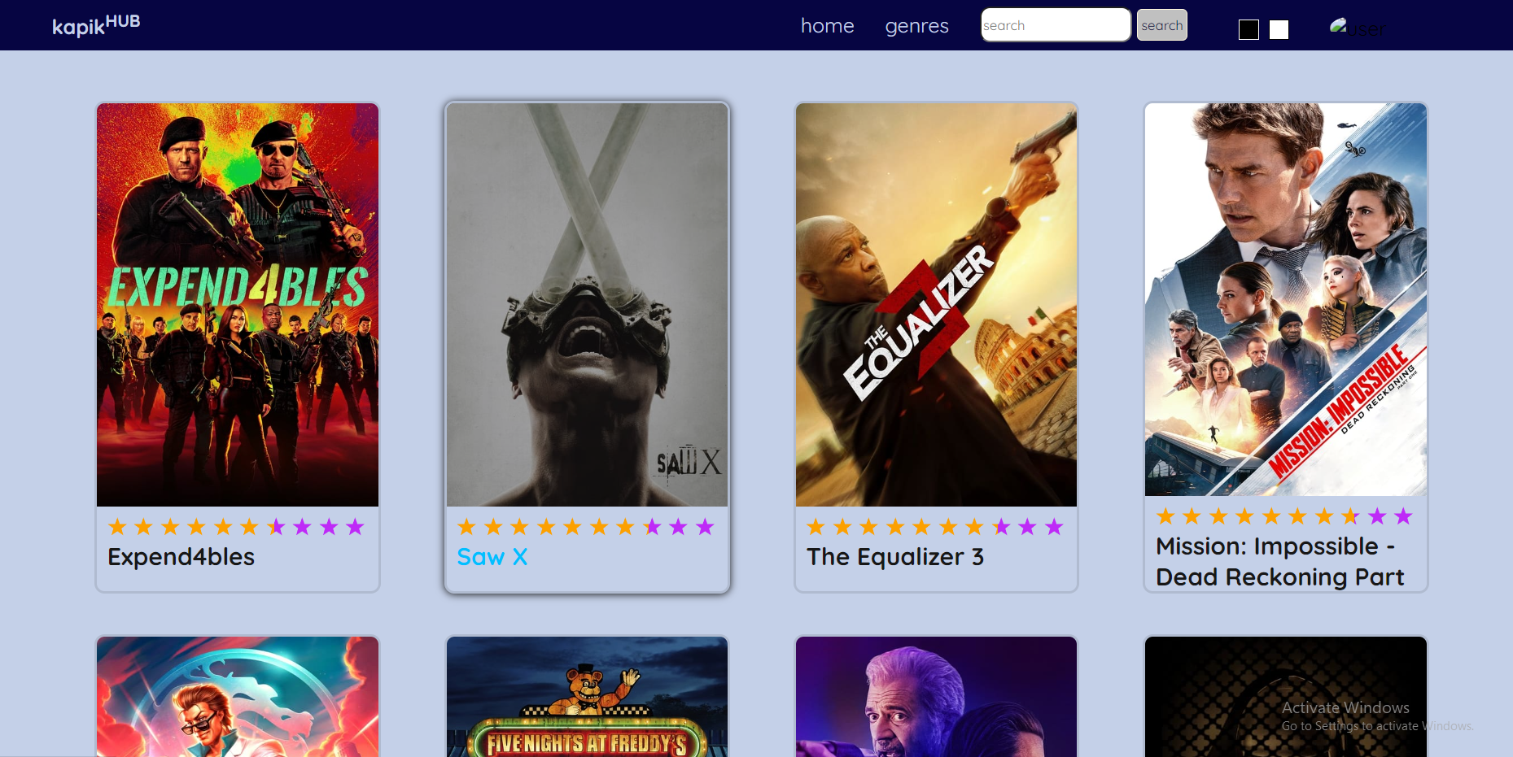
Uses ReactJS: Kapikhub

Slide 31
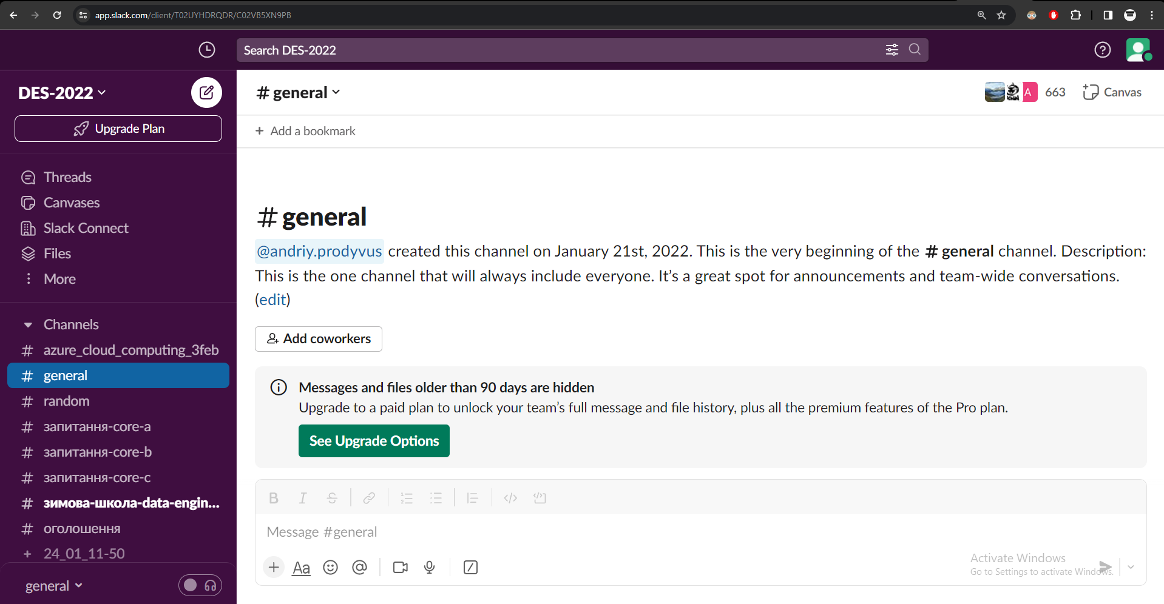
Uses ReactJS: Slack (browser version)

Slide 32
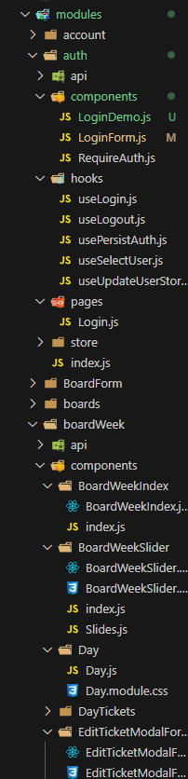
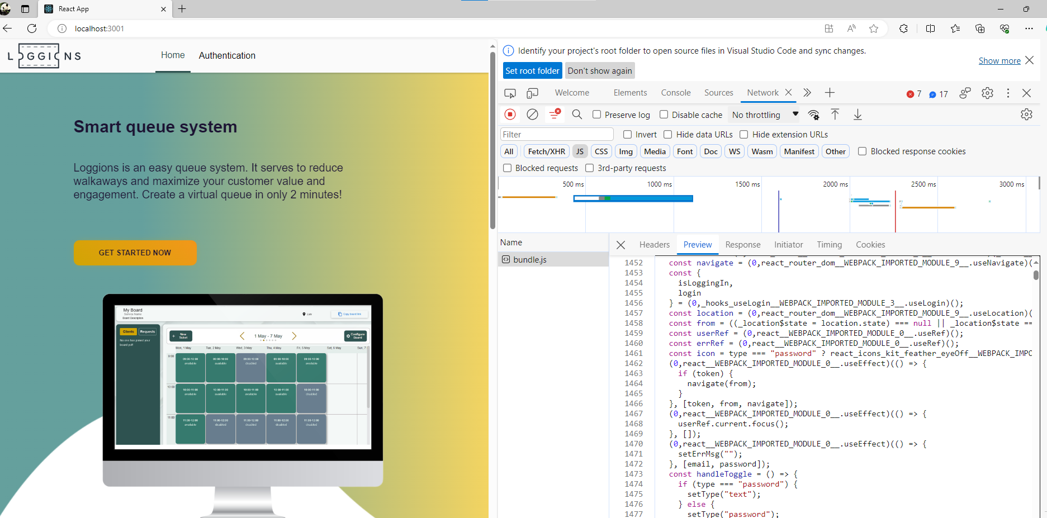

SPA and browsers

Slide 33
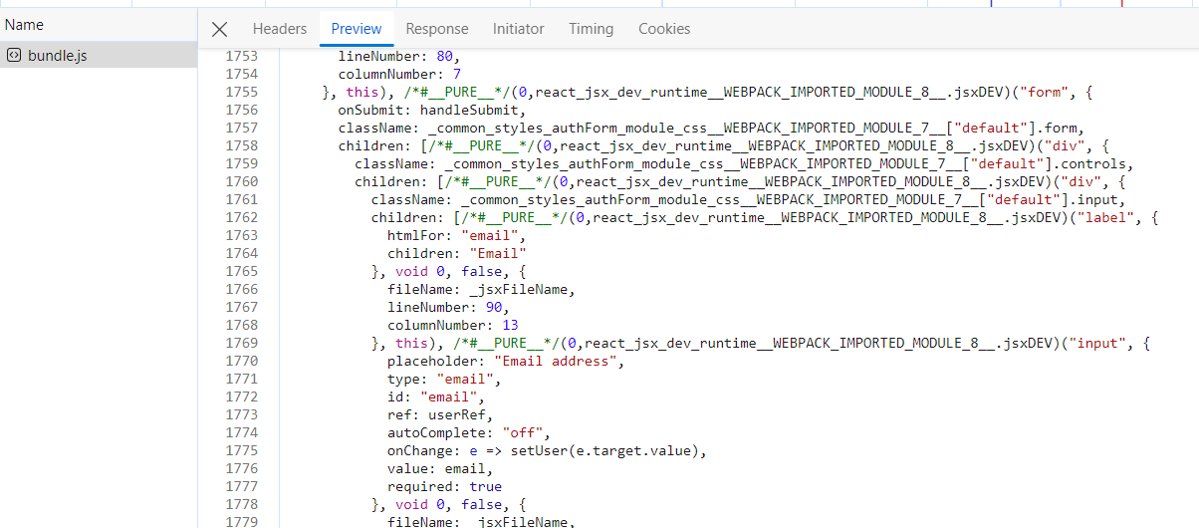
Virtual DOM
The Virtual DOM is a lightweight in-memory representation of the actual browser DOM.
Compiled JSX will affect only the virtual DOM, which will cause the Reconciliation.

Slide 34





Virtual DOM

Slide 35



Virtual DOM
Reconciliation
Virtual DOM
Browser DOM

Slide 36



Uses ReactJS: Instagram
VS
VS
The Most Popular JavaScript Frameworks in 2023

Slide 37

React and its friends: Create React App
Create React App is the most common command line tool for creating a new React application

Slide 38




React and its friends: React Router

Slide 39


React and its friends: Typescript

Slide 40




React and its friends: Redux

Slide 41


React and its friends: NextJS

Slide 42
Summarize & questions
What happens with the component, when its state changes?
What is Virtual DOM and Reconciliation?
Where to put AJAX code in functional component?
What is the only required tool to implement SPA using ReactJS?
a) Redux
b) React Router c) NextJS
d) Client-side Java Script

Slide 43

What’s next?
Learn about hooks:
Learn about tools:
useEffect
useState
useRef
useMemo
useCallback
useContext
useReducer
useImperativeHandle
useLayoutEffect
Redux
React router
NextJS
Css in React Components
Axios
Querying libraries
Presentation resources
and recommended content

